Slide 1
Office of Massachusetts Attorney General
Maura Healey

Slide 2
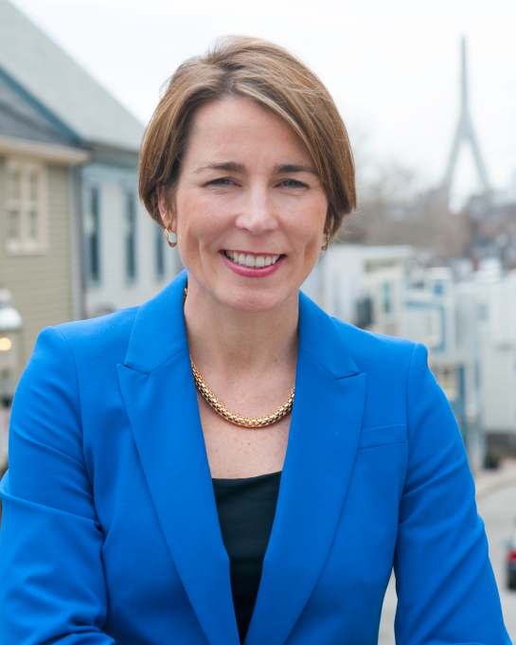
The Job of the Attorney General
Attorney General
Maura Healey is the chief lawyer and law enforcement officer of the Commonwealth of Massachusetts.
© 2015 Massachusetts Office of the Attorney General
Notes:
Largest law office in the state. <- not true (mc)

Slide 3
Who the AGO Serves & How
Who:
The Commonwealth
How:
Four Major Ways this Work is Executed
Residents of the Commonwealth and their public interests
State departments, officers, and commissions
Groups of consumers
Investigation
Enforcement
Prevention
Policy
© 2015 Massachusetts Office of the Attorney General

Slide 4
How the AGO is Organized
Executive
Public Protection & Advocacy
Criminal
Energy & Environment
Government
Healthcare & Fair Competition
Six Bureaus
© 2015 Massachusetts Office of the Attorney General

Slide 5
Executive Bureau
Description
Supports the AGO through:
Community Engagement; Administration; Public information; Policy development;
Operational; Information technology; Human resources; and
Fiscal management services.
Divisions of the Executive Bureau
Policy
Victim Witness Services
Communications
Community Engagement
Public Inquiry and Assistance Center
© 2015 Massachusetts Office of the Attorney General

Slide 6
Public Protection & Advocacy Bureau
Description
Protecting students against predatory for-profit schools;
Ensuring that workers are paid the wages they are owed;
Combating discrimination by landlords and employers;
Keeping struggling homeowners in their homes through loan modifications; and
Fighting for consumers against scams and other deceptive business practices.
Divisions of the Public Protection & Advocacy Bureau
Civil Investigations
Consumer Protection
Fair Labor
Insurance and Financial Services
HomeCorps
© 2015 Massachusetts Office of the Attorney General
Notes:
Civil Rights Division
Enforces and safeguards Constitutional and statutory civil rights and liberties on behalf of Massachusetts residents and visitors
The Division works to end discrimination on the basis of race, national origin, gender, religion, sexual orientation, age, and disability
Works to ensure equal and meaningful opportunity to each Massachusetts resident to participate in a civic society in areas such as education, housing, employment, financial services, healthcare, transportation, voting and marriage
In addition, the Division works to protect individual rights of free speech and privacy

Slide 7
Resources Would your organization like a presentation?
Staff from the Attorney General’s Office provide free outreach and education presentations statewide on a variety of topics:
Civil Rights
The new Earned Sick Time law
The new Domestic Workers Bill of Rights
Worker’s Rights and Fair Labor Laws
Scams and ID theft
Contractual agreements (ie: home improvement)
Landlord and tenant rights
Shopping Rights
Purchasing a vehicle
Financial awareness
Notes:
Consumer Hotline
Answers a variety of general questions and providing awareness of consumer protection laws
Provides resources and referrals to other state and federal agencies

Slide 8
Grants
US$ 14 million
Local Consumer Programs
Face to Face Mediation Programs
Behavioral Health Grants
Asthma Grant with DPH
Community Based Foreclosure Prevention Grants
Distressed Properties Identification and Revitalization (DPIR)
Abandoned Housing Initiative
Innovative to Improve Access and Opportunity for Individuals with Disabilities
Game Change Anti-Violence Grants to DV/SA Agencies

Slide 9
Where the AGO is located
Attorney General Maura Healey and her staff engage with every city and town of the Commonwealth. The Attorney General’s Office also runs a statewide Public Inquiry and Assistance Center, and supports over thirty regional local consumer and face to face mediation programs, which you may choose to contact.
Central Massachusetts
10 Mechanic Street Worcester
Boston
One Ashburton Place and
100 Cambridge Street
Western Massachusetts 1350 Main Street
Springfield
Southeastern Massachusetts 105 William Street New Bedford

Slide 10
Contact Us
www.mass.gov/ago
617-727-2200
File a Complaint about an Unfair or Deceptive Trade Practice
617-727-8400
www.eform.ago.state.ma.us
Notes:
Say what PIAC does

Slide 11
Resources Have a Complaint or Question?
General Assistance
Consumer Hotline: (617) 727-8400
E-Complaint form: www.eform.ago.state.ma.us
Specific Hotlines
HomeCorps (617) 573-5333
Elder Hotline (888) 243-5337
Fair Labor Division (617) 727-3465
Civil Rights Division (617) 727-2200
Medicaid Fraud Tipline (617) 963-2360
Insurance Fraud Tipline (617) 537- 5330
Insurance & Health Care Consumer Helpline (888) 830-6277
Notes:
Consumer Hotline
Answers a variety of general questions and providing awareness of consumer protection laws
Provides resources and referrals to other state and federal agencies

